Slide 1

Maximum A Posteriori
Chris Piech
CS109, Stanford University

Slide 2
Previously in CS109…

Slide 3
Game of Estimators
Estimators
Maximum
Likelihood
Non spoiler: this didn’t happen in game of thrones

Slide 4
Maximum Likelihood of Data
Consider n I.I.D. random variables X₁, X₂, ..., X_{n}
X_{i} is a sample from density function f(X_{i} | θ)

Slide 5
Side Plot
argmax
argmax of log
Gradient Ascent
Mother of optimizations?

Slide 6
Gradient Ascent
Especially good if function is convex
Walk uphill and you will find a local maxima
(if your step size is small enough)

Slide 7
Gradient Ascent
Initialize: θ_{j} = 0 for all 0 ≤ j ≤ m
Repeat many times:
gradient[j] = 0 for all 0 ≤ j ≤ m
Calculate all gradient[j]’s based on data and current setting of theta
𝜃_{j} += η * gradient[j] for all 0 ≤ j ≤ m

Slide 8
Our Path
Neural Networks
Linear
Regression
Naïve
Bayes
Logistic
Regression
Unbiased
estimators
Maximizing
likelihood
Bayesian
estimation

Slide 9
Episode 2
The Song of The Last Estimator

Slide 10
Something rotten
in the world of MLE

Slide 11
Foreshadowing..

Slide 12
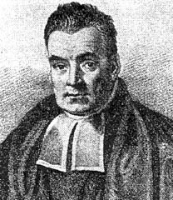
Need a Volunteer
So good to see you again!

Slide 13
Two Envelopes
I have two envelopes, will allow you to have one
One contains $X, the other contains $2X
Select an envelope
Open it!
Now, would you like to switch for other envelope?
To help you decide, compute E[$ in other envelope]
Let Y = $ in envelope you selected
Before opening envelope, think either equally good
So, what happened by opening envelope?
And does it really make sense to switch?

Slide 14
Thinking Deeper About Two Envelopes
The “two envelopes” problem set-up
Two envelopes: one contains $X, other contains $2X
You select an envelope and open it
Let Y = $ in envelope you selected
Let Z = $ in other envelope
E[Z | Y] above assumes all values X (where 0 < X < ∞) are equally likely
Note: there are infinitely many values of X
So, not true probability distribution over X (doesn’t integrate to 1)

Slide 15
All Values are Equally Likely?
Infinite powers of two…
p(X)
0
10
20
40
60
80
100
X

Slide 16
Subjectivity of Probability
Belief about contents of envelopes
Since implied distribution over X is not a true probability distribution, what is our distribution over X?
Frequentist: play game infinitely many times and see how often different values come up.
Problem: I only allow you to play the game once
Bayesian probability
Have prior belief of distribution for X (or anything for that matter)
Prior belief is a subjective probability
By extension, all probabilities are subjective
Allows us to answer question when we have no/limited data
E.g., probability a coin you’ve never flipped lands on heads
As we get more data, prior belief is “swamped” by data

Slide 17
Subjectivity of Probability
p(X)
0
10
20
40
60
80
100
X

Slide 18
The Envelope, Please
Bayesian: have prior distribution over X, P(X)
Let Y = $ in envelope you selected
Let Z = $ in other envelope
Open your envelope to determine Y
If Y > E[Z | Y], keep your envelope, otherwise switch
No inconsistency!
Opening envelope provides data to compute P(X | Y) and thereby compute E[Z | Y]
Of course, there’s the issue of how you determined your prior distribution over X…
Bayesian: Doesn’t matter how you determined prior, but you must have one (whatever it is)
Imagine if envelope you opened contained $20.01

Slide 19
Envelope Summary:
Probabilities are beliefs
Incorporating prior beliefs is useful

Slide 20
Priors for Parameter Estimation?

Slide 21
Flash Back: Bayes Theorem
Bayes’ Theorem (θ = model parameters, D = data):
Likelihood: you’ve seen this before (in context of MLE)
Probability of data given probability model (parameter θ)
Prior: before seeing any data, what is belief about model
I.e., what is distribution over parameters θ
Posterior: after seeing data, what is belief about model
After data D observed, have posterior distribution p(θ | D) over parameters θ conditioned on data. Use this to predict new data.
“Posterior”
“Likelihood”
“Prior”
P(D | θ) P(θ)
P(D)
P(θ | D) =

Slide 22
Computing P(θ | D)
Bayes’ Theorem (θ = model parameters, D = data):
We have prior P(θ) and can compute P(D | θ)
But how do we calculate P(D)?
Complicated answer:
Easy answer: It does not depend on θ, so ignore it
Just a constant that forces P(θ | D) to integrate to 1
P(D | θ) P(θ)
P(D)
P(θ | D) =

Slide 23
Maximum A Posteriori
Maximum Likelihood Estimation
Maximum A Posteriori

Slide 24
Most important slide of today

Slide 25
Maximum A Posteriori
Recall Maximum Likelihood Estimator (MLE) of θ
Maximum A Posteriori (MAP) estimator of θ :
where g(θ ) is prior distribution of θ .
As before, can often be more convenient to use log:
MAP estimate is the mode of the posterior distribution

Slide 26
Maximum A Posteriori
Estimated
parameter
Log prior
Sum of
log likelihood
Chose the value of theta
that maximizes:

Slide 27
MLE vs MAP
Maximum Likelihood Estimation
Maximum A Posteriori

Slide 28
Gotta get that intuition

Slide 29
P(θ | D) For Bernoulli
Prior: θ ~ Beta(a, b); D = {n heads, m tails}
Estimate p, aka θ
Notes:
29

Slide 30
P(θ | D) For Bernoulli
Prior: θ ~ Beta(a, b); D = {n heads, m tails}
Estimate p, aka θ
Notes:
30

Slide 31
Hyper Parameters
Hyperparameter
a
b
a, b are fixed
Prior
p
Data distribution
X₁
X_{n}
X₂
MAP will estimate the most likely value of p for this model

Slide 32
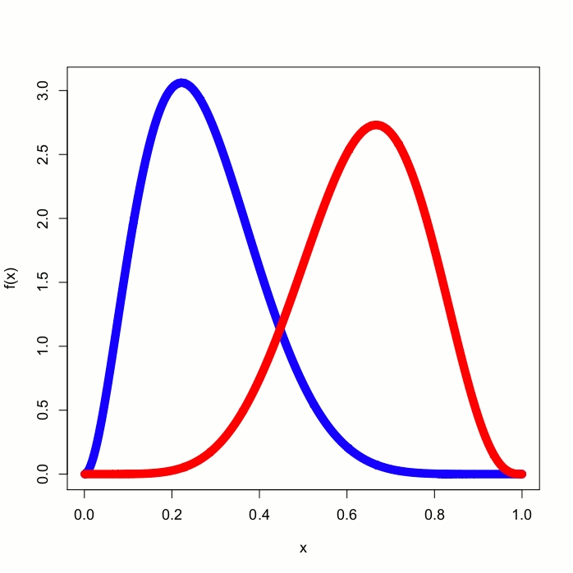
Where’d Ya Get Them P(𝜃)?
θ is the probability a coin turns up heads
Model θ with 2 different priors:
P₁(θ) is Beta(3,8) (blue)
P₂(θ) is Beta(7,4) (red)
They look pretty different!
Now flip 100 coins; get 58 heads and 42 tails
What do posteriors look like?
Notes:
32

Slide 33
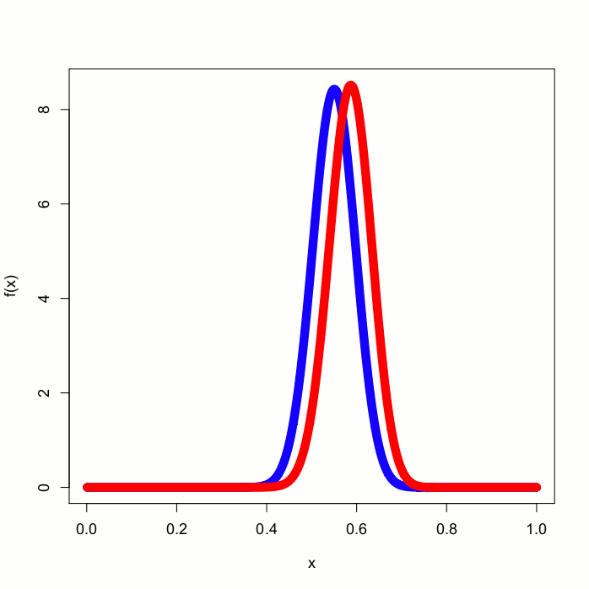
It’s Like Having Twins
argmax returns the mode
As long as we collect enough data, posteriors will converge to the true value!
Notes:
33

Slide 34
Conjugate Distributions Without Tears
Just for review…
Have coin with unknown probability θ of heads
Our prior (subjective) belief is that θ ~ Beta(a, b)
Now flip coin k = n + m times, getting n heads, m tails
Posterior density: (θ | n heads, m tails) ~ Beta(a + n, b +\m)
Beta is conjugate for Bernoulli, Binomial, Geometric, and Negative Binomial
a and b are called “hyperparameters”
Saw (a + b – 2) imaginary trials, of those (a – 1) are “successes”
For a coin you never flipped before, use Beta(x, x) to denote you think coin likely to be fair
How strongly you feel coin is fair is a function of x

Slide 35
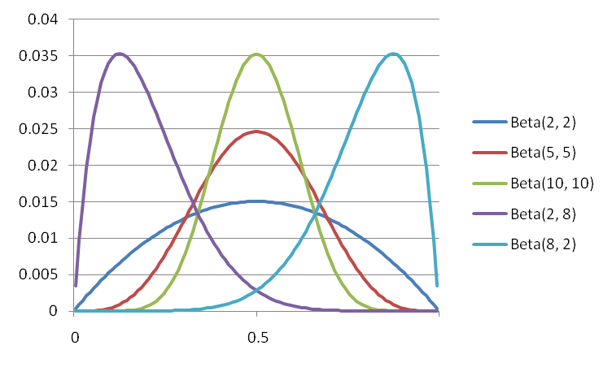
Mo’ Beta

Slide 36
Gonna Need Priors
Parameter
Distribution for Parameter
Don’t need to know Inverse Gamma. But it will know you…

Slide 37
Good Times with Gamma
Gamma(k, 𝜃) distribution
Conjugate for Poisson Rate
Also conjugate for Exponential, but we won’t delve into that
Intuitive understanding of hyperparameters:
Saw k total imaginary events during 𝜃 prior time periods
4.0
4.0
4.0
2.0

Slide 38
Good Times with Gamma
Gamma(k, 𝜃) distribution
Conjugate for Poisson Rate
Also conjugate for Exponential, but we won’t delve into that
Intuitive understanding of hyperparameters:
Saw k total imaginary events during 𝜃 prior time periods
Updating with observations
After observing n events during next t time periods...
... posterior distribution is Gamma(k + n, 𝜃 + t)
…MAP estimator for Poisson with Gamma prior is (k+n)/(𝜃 + t)
Example: Prior for rate is Gamma(10, 5)
Saw 10 events in 5 time periods. Like observing at rate = 2
Now see 11 events in next 2 time periods → Gamma(21, 7)
MAP rate = 3

Slide 39
Reviving an Old Story Line
The Multinomial Distribution Mult(p₁, … , p_{k})

Slide 40
Multinomial is Multiple Times the Fun
Dirichlet(a₁, a₂, ..., a_{m}) distribution
Conjugate for Multinomial
Dirichlet generalizes Beta in same way Multinomial generalizes Bernoulli
Intuitive understanding of hyperparameters:
Saw imaginary trials, with (a_{i} – 1) of outcome i
Updating to get the posterior distribution
After observing n₁ + n₂ + ... + n_{m}, new trials with n_{i} of outcome i...
... posterior distribution is Dirichlet(a₁ + n₁, a₂ + n₂, ..., a_{m} + n_{m})

Slide 41
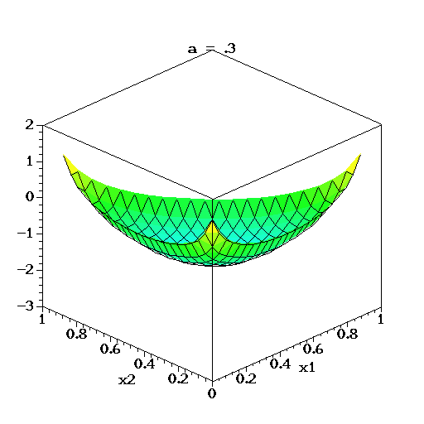
Best Short Film in the Dirichlet Category
And now a cool animation of Dirichlet(a, a, a)
This is actually log density (but you get the idea…)
Thanks Wikipedia!

Slide 42
Example: Estimating Die Parameters

Slide 43
Your Happy Laplace
Recall example of 6-sides die rolls:
X ~ Multinomial(p₁, p₂, p₃, p₄, p₅, p₆)
Roll n = 12 times
Result: 3 ones, 2 twos, 0 threes, 3 fours, 1 fives, 3 sixes
MLE: p₁=3/12, p₂=2/12, p₃=0/12, p₄=3/12, p₅=1/12, p₆=3/12
Dirichlet prior allows us to pretend we saw each outcome k times before. MAP estimate:
Laplace’s “law of succession”: idea above with k = 1
Laplace estimate:
Laplace: p₁=4/18, p₂=3/18, p₃=1/18, p₄=4/18, p₅=2/18, p₆=4/18
No longer have 0 probability of rolling a three!

Slide 44
The last estimator has risen…

Slide 46
One Shot Learning
Single training example:
Test set:

Slide 48
Is Peer Grading Accurate Enough?
Peer Grading on Coursera HCI.
31,067 peer grades for 3,607 students.
Tuned Models of Peer Assessment. C Piech, J Huang, A Ng, D Koller

Slide 49
Is Peer Grading Accurate Enough?
1. Defined random variables for:
True grade (s_{i}) for assignment i
Observed (z_{i}^{j}) score for assign i
Bias (b_{j}) for each grader j
Variance (r_{j}) for each grader j
2. Designed a probabilistic model that
defined the distributions for all random variables
= hyperparameter
Tuned Models of Peer Assessment. C Piech, J Huang, A Ng, D Koller

Slide 50
Is Peer Grading Accurate Enough?
1. Defined random variables for:
True grade (s_{i}) for assignment i
Observed (z_{i}^{j}) score for assign i
Bias (b_{j}) for each grader j
Variance (r_{j}) for each grader j
2. Designed a probabilistic model that
defined the distributions for all random variables
3. Found variable assignments using MAP estimation given the observed data
Inference or Machine Learning
Tuned Models of Peer Assessment. C Piech, J Huang, A Ng, D Koller

Slide 51
Improved Accuracy
Before:
After:
Some students were getting very erroneous grades
99% within 10pp
Error is based on ground truth assignments. Results are across all assignments (~10,000 submissions)

Slide 52
Next time: Machine Learning algorithms

Slide 53
It’s Normal to Be Normal
Normal(μ₀, σ₀²) distribution
Conjugate for Normal (with unknown μ, known σ²)
Intuitive understanding of hyperparameters:
A priori, believe true μ distributed ~ N(μ₀, σ₀²)
Updating to get the posterior distribution
After observing n data points...
... posterior distribution for μ is:

